Slide 1
MODFLOW 6 TRANSPORT

Slide 2
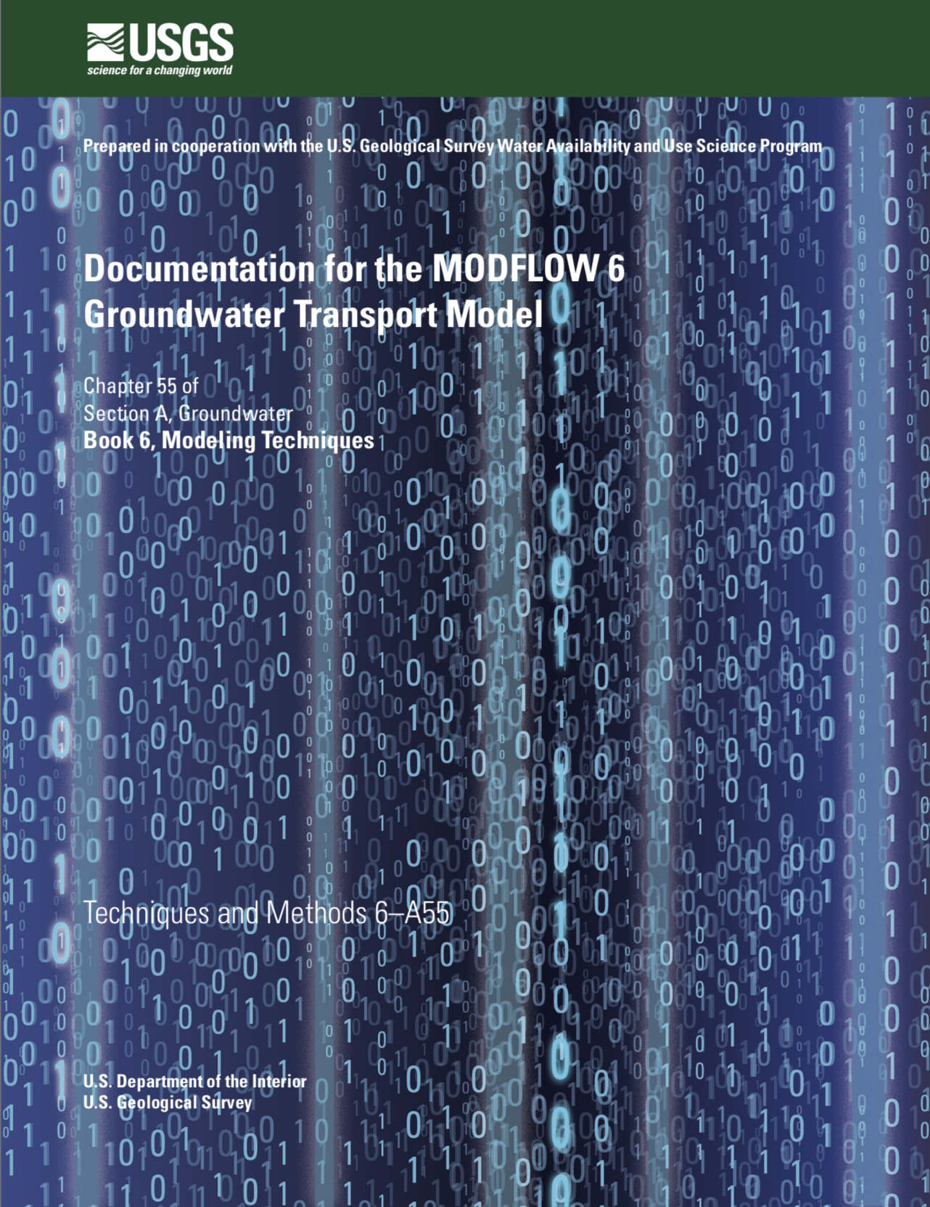
Transport Model
New model type in MODFLOW 6 called GWT
Compatible with unstructured grids and the Newton flow formulation
Simulates advection, dispersion, sources and sinks, sorption, decay, and any number of immobile domain
Implicit formulation (no particles)
Second-order TVD
Optional use of XT3D for dispersion

Slide 3
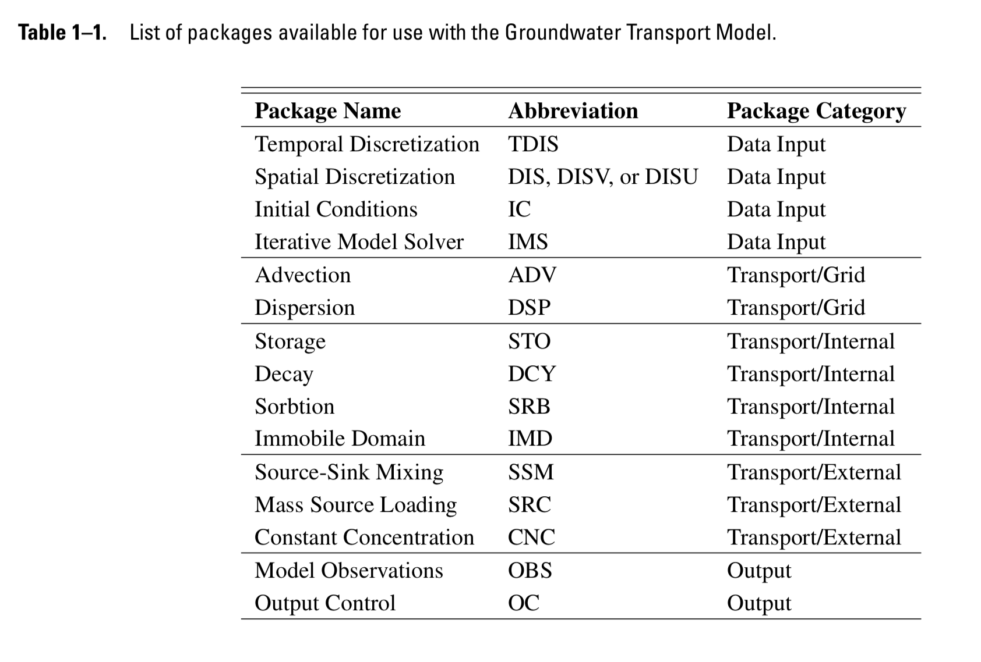
GWT Packages

Slide 4
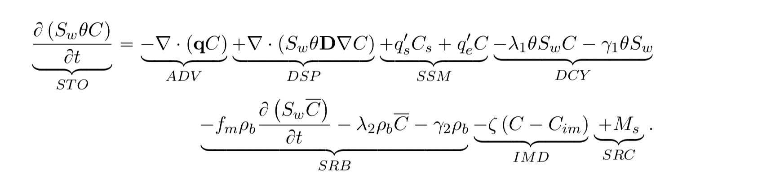
Transport Equation

Slide 5
Limitations
Flow and transport grids must be identical
Time step lengths are specified by the user in the TDIS package
No particle methods
Version 1:
No transport across different model grids
Cannot run independently (must run with GWF6 in a simulation)
Single species, but can specify multiple models

Slide 6
Newton Formulation for Dry Cells
Q_{rch}
1
2
h₁
h₂
3
h₃

Slide 7
Transport Formulation for Dry Cells
Q_{rch}C_{rch}
1
C₁ = C_{rch}
2
C₂ = C_{rch}
3
C₃ = f(C_{rch}, …)

Slide 8
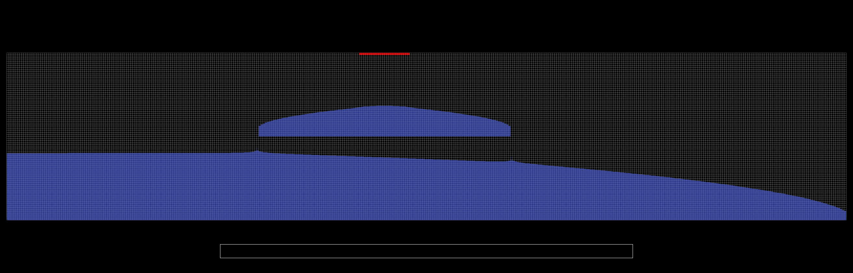
Keating Example
Transport through dry cells

Slide 9
SEAWAT Capabilities
Simulated concentrations can be used to calculate densities used by the GWF Buoyancy Package
Flow and transport can be solved in a single matrix (more to do on this…)
Compatible with unstructured grids and the Newton flow formulation

Slide 10
SEAWAT Freshwater Head Formulation
SEAWAT uses a freshwater head formulation
Problem: freshwater head is not the water table
Notes:
q = - K_0 \left [ \nabla h_f + \left ( \frac{\rho}{\rho_0} - 1 \right ) \nabla z \right ]

Slide 11
Alternative Hydraulic Head Formulation
What about a hydraulic head formulation?
Head is the dependent variable and the water table
Notes:
q = - K_0 \left [ \nabla h_f + \left ( \frac{\rho}{\rho_0} - 1 \right ) \nabla z \right ]

Slide 12
Comparison for Henry Problem

Slide 13
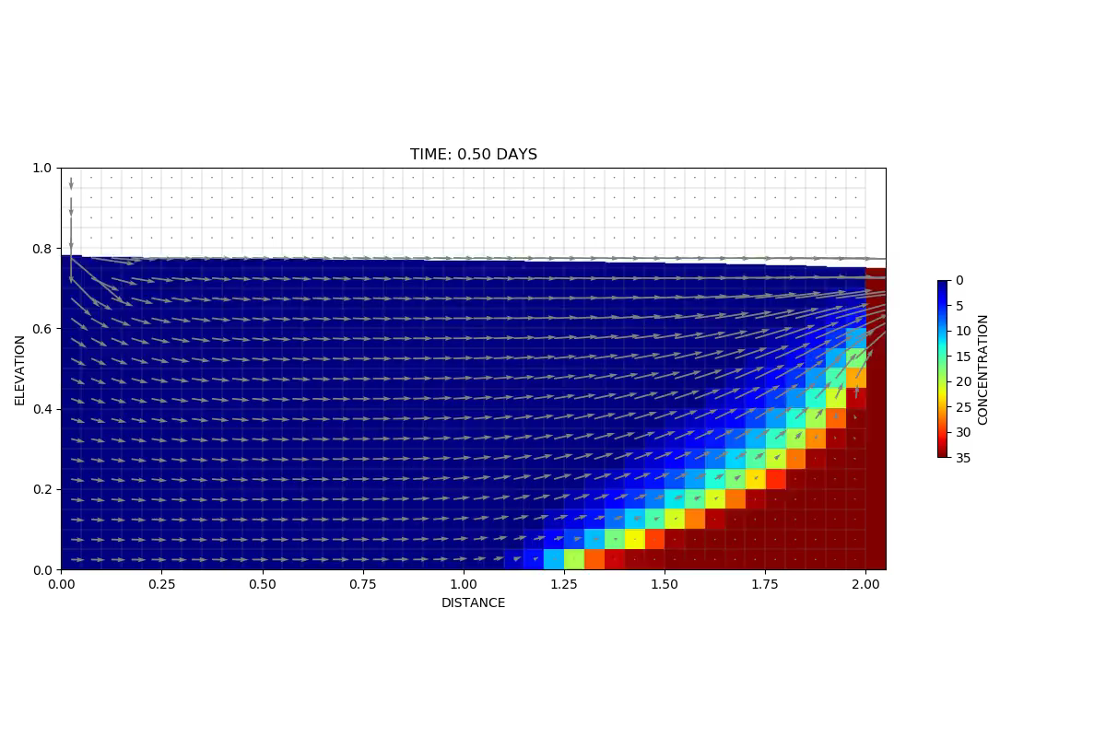
MODFLOW 6 Animation
Notes:
10 seconds to run this.

Slide 14
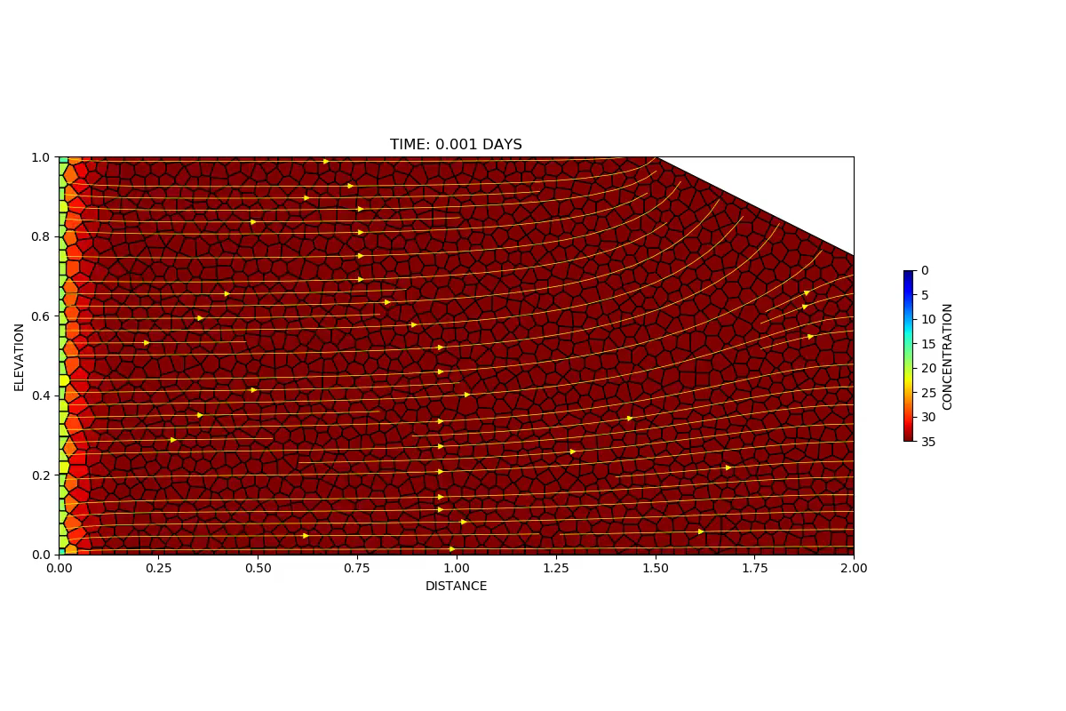
Ongoing Work
Unstructured cross sections

Slide 15
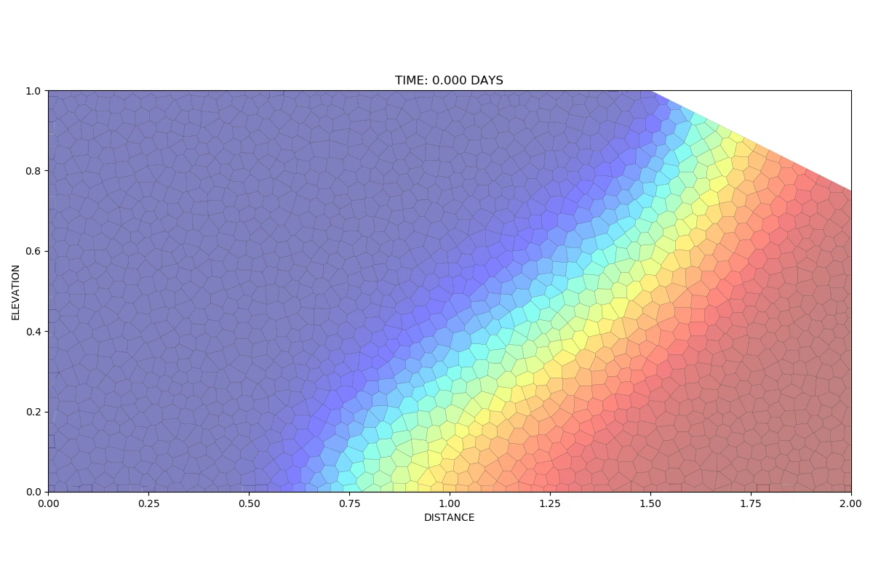
Ongoing Work
Particle Tracking

